Slide 1


SQL PROJECT
ONLINE CINEMA PLAYGROUND
made by: Bizhanov Madiyar, SE-2016

Slide 2

AGENDA
INTRODUCTION
MAIN IDEA
DECISION
BENEFIT
CONCLUSION

Slide 3

INTRODUCTION
Netflix is ​​an American entertainment company, one of the main goal of this company is to provide access to watch films and series in the network.

Slide 4

MAIN IDEA
It was decided to create a database that will serve companies such as Netflix to provide information about the cinema to the clients. By help SQL we created this kind of database, the aim of the database is to show up data of the cinema. It is needed for providing information about the cinema, SUCH AS by whom this cinema was directed, recorded, edited, who took participation as an actor and etc.

Slide 5
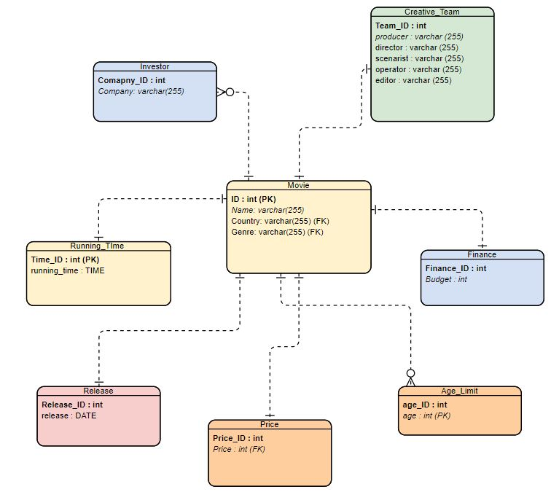
ER DIAGRAM

Slide 6
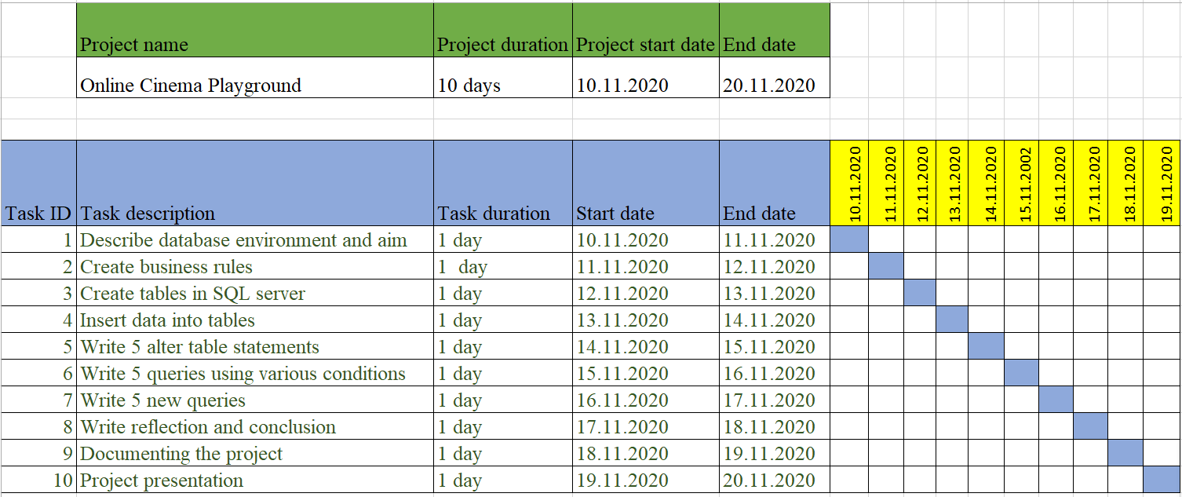
2020
GANTT CHART
2020
Day 1
4
7
10
13
16
19
22
25
28

Slide 7

DECISION
The DATABASE system should solve ignorance pieces of knowledge information about the cinema. THE information THAT iS related to the cinema can be available to the database, e.g. Cast team, Genre, Country and etc.

Slide 8

BENEFIT
WHAT HAVE I LEARNED?
• I got experience of making project
• I improved and Consolidated my skills and knowledge OF PROGRAMMING BY USING SQL
• I learned TO EXPORT AND IMPORT DATABASES THROUGH PGADMIN4

Slide 9

CONCLUSION
CONCLUSION
To sum up, I faced many difficulties and challenges while I was making this project, but anyway I was able to do it and I have finished this project. I am pretty confident that this database is really useful for use in a real-life, especially in a covid-19 period when many of the people are staying at home and working or studying remotely.

